Slide 1


ETHICAL HACKING INTERNSHIP -- Project Problem Statement
Created by Pritam bera

Slide 2
Task 1
In Session 22 we introduced you to portswigger labs. Portswigger is a website which has so many vulnerable labs which helps you to learn about other vulnerabilities in real life. You can visit Portswigger labs at https://portswigger.net/
So the exact task for you now is there are several XSS labs on this website https://portswigger.net/web-security/all-labs. You can just choose any 5 of them and solve it. We are leaving the choice up to you.

Slide 3
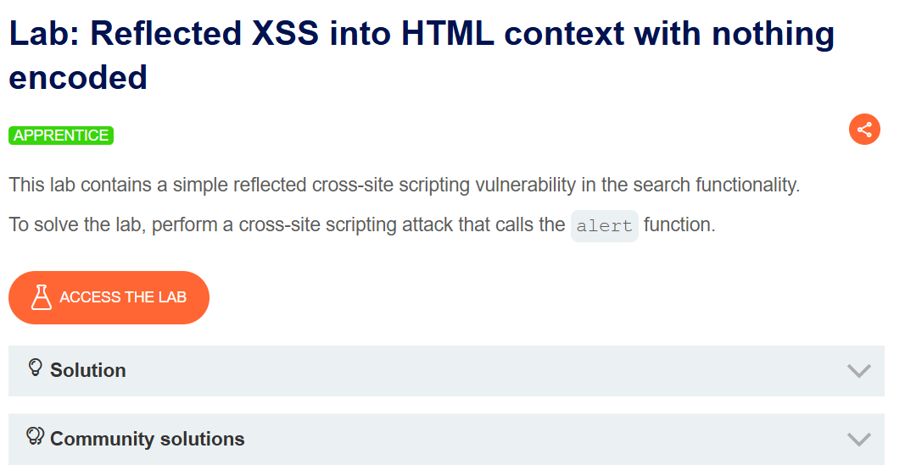
Lab 1: Reflected XSS into HTML context with nothing encoded

Slide 4
Created by Pritam
Steps………………….
Step1: Open the BurpSuite (Portswigger).
Step2: Login Your Account.
Step3: click proxy and go to open browser.
Step4: search the url cross-site scripting(XSS) Labs.
Step5: then go to left-corner you will find the view labs.
Step6: select any XSS Labs and see the solution and copy the script.
Step7: click access the lab and paste the script blog box.
Step8: Finally you found the flag and the room is completed.

Slide 5
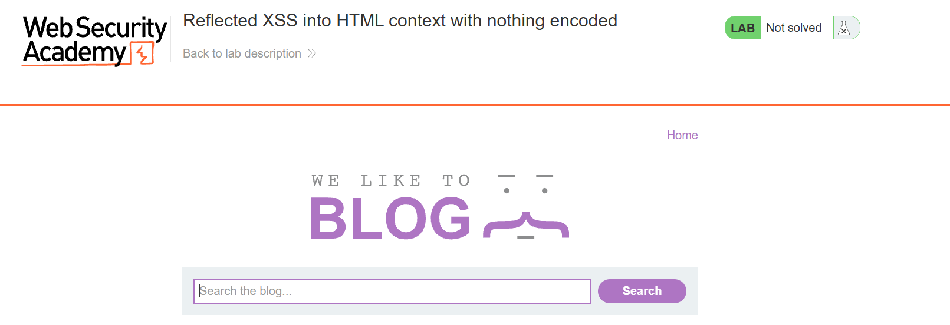
created by Pritam
(Access the LAB.)
We use the script “ <script>alert(1)</script> “

Slide 6
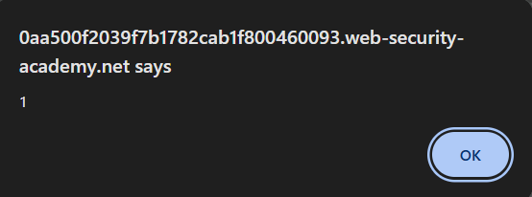
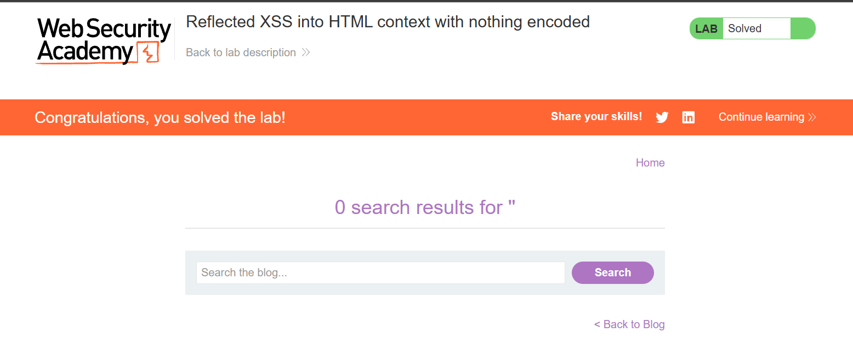
Created by pritam
(The flag we found.)
(Lab Solved)

Slide 7
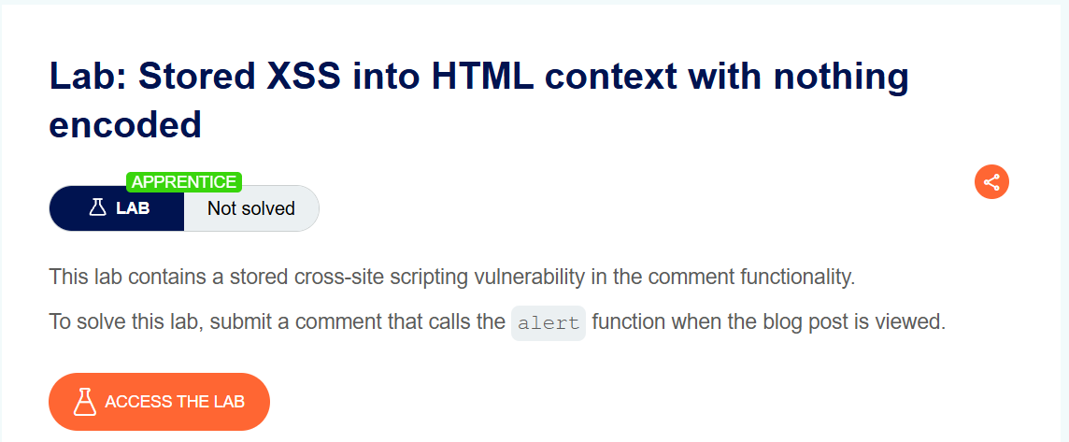
LAB 2: Stored XSS into HTML context with nothing encoded

Slide 8
Created by Pritam
Steps………………….
Step1: Open the BurpSuite (Portswigger).
Step2: Login Your Account.
Step3: click proxy and go to open browser.
Step4: search the url cross-site scripting(XSS) Labs.
Step5: then go to left-corner you will find the view labs.
Step6: select any XSS Labs and see the solution and copy the script.
Step7: click access the lab and paste the script blog box on the post comment box.
Step8: Finally you found the flag and the room is completed.

Slide 9

Created By Pritam
This type of page will show. Then click the view post.

Slide 10
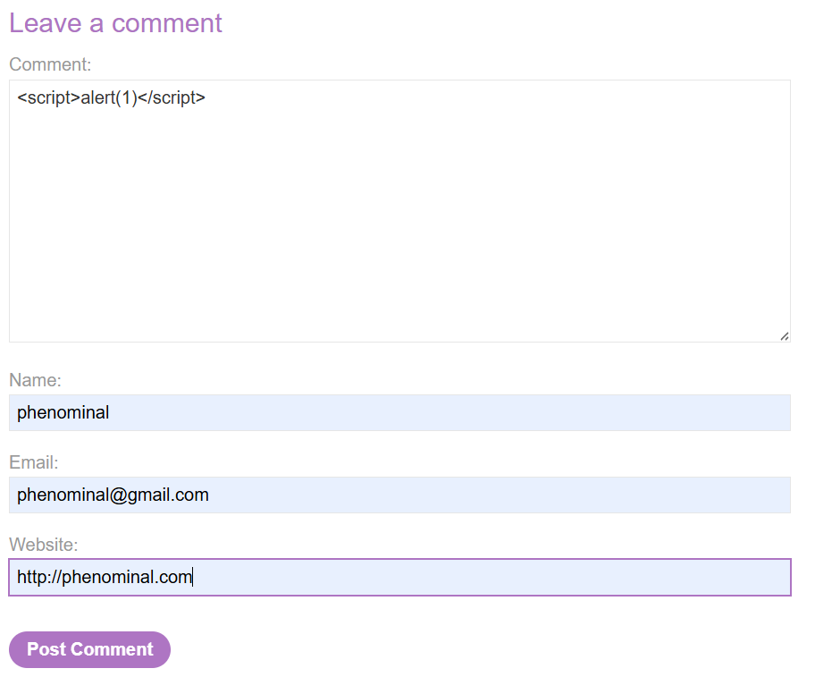
Created By Pritam
Here the script will run on comment box and add name, email and website will put on the post comment boxes.

Slide 11
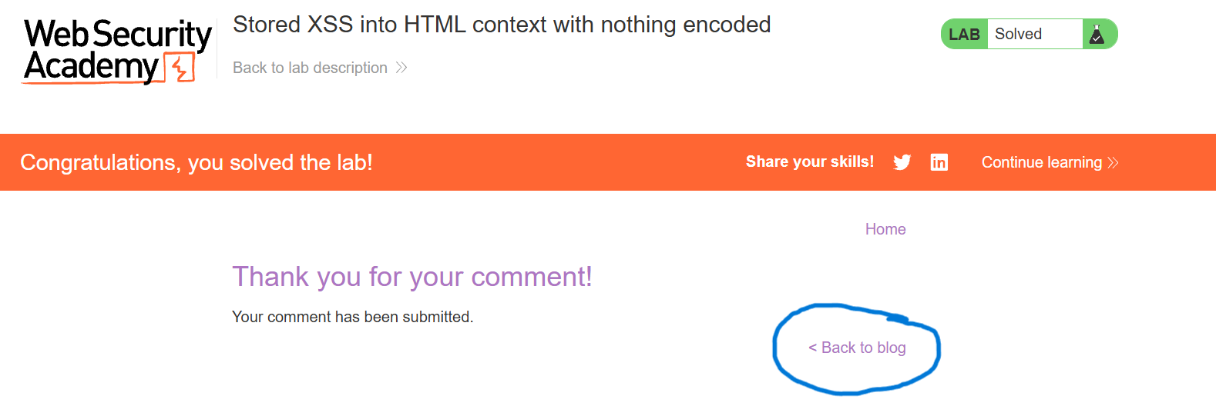
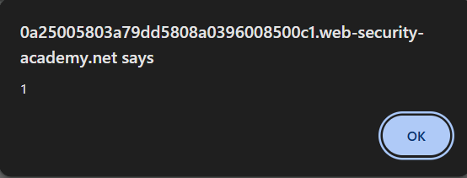
Created by pritam
(Click back to blog)
(Found the Flag.)

Slide 12
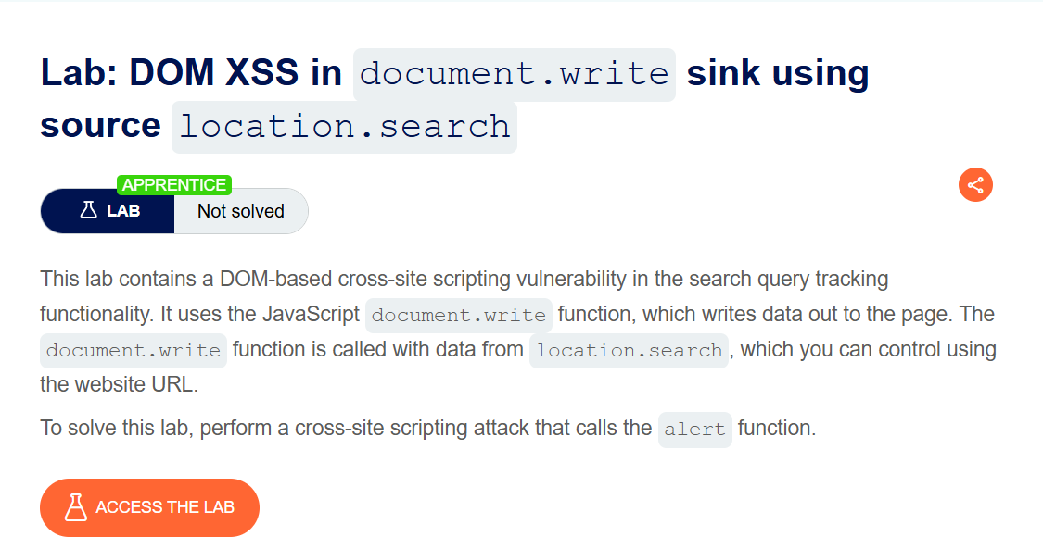
LAB 3: DOM XSS in document.write sink using source location.search

Slide 13
Steps………………….
Step1: Open the BurpSuite (Portswigger).
Step2: Login Your Account.
Step3: click proxy and go to open browser.
Step4: search the url cross-site scripting(XSS) Labs.
Step5: then go to left-corner you will find the view labs.
Step6: select any XSS Labs and see the solution and copy the script.
Step7: click access the lab and click the view post.
Step8: inspect the photo for showing the html script & paste the script blog box.
Step9: Finally you found the flag and the room is completed.

Slide 14

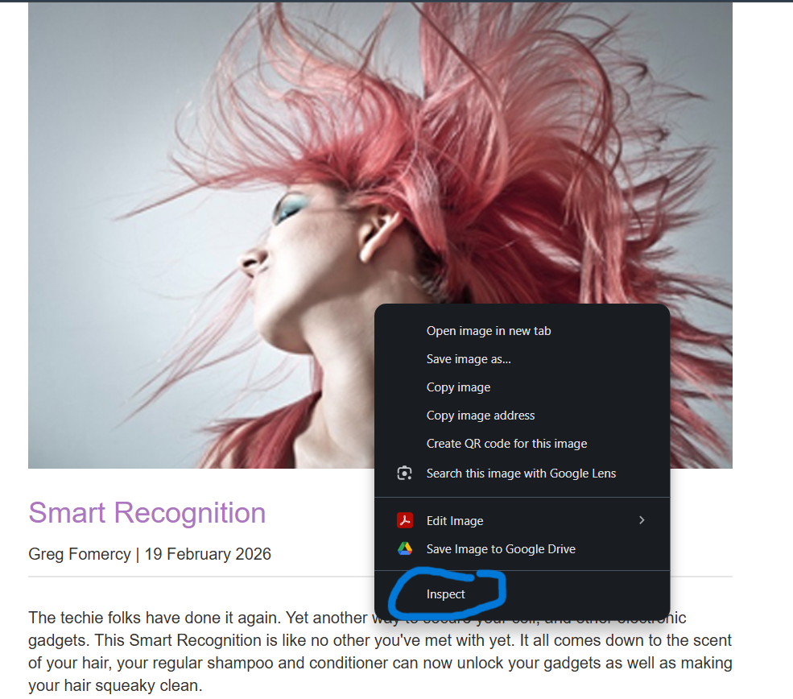
Created by pritam
(Click the view post)
(Click right click for Inspecting to find the source code.)

Slide 15
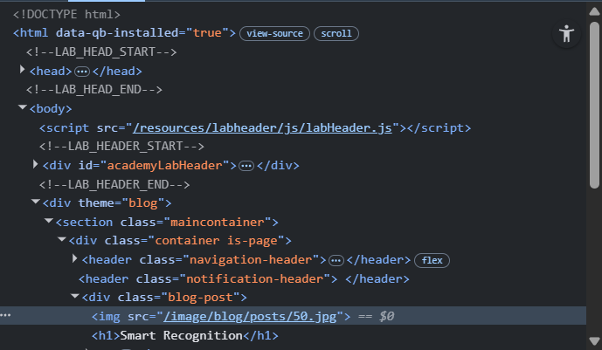
Created by pritam
We find the source code and see the
<img src=“/image/blog/posts/50.jpg”>

Slide 16

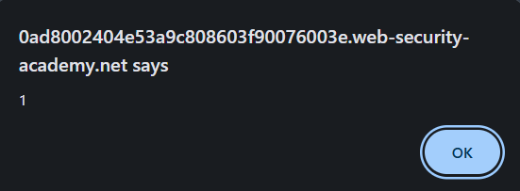
Created by pritam
(We write the script “><svg onload=alert(1)> on the dialog box.)
(Finally we found the flag.)

Slide 17
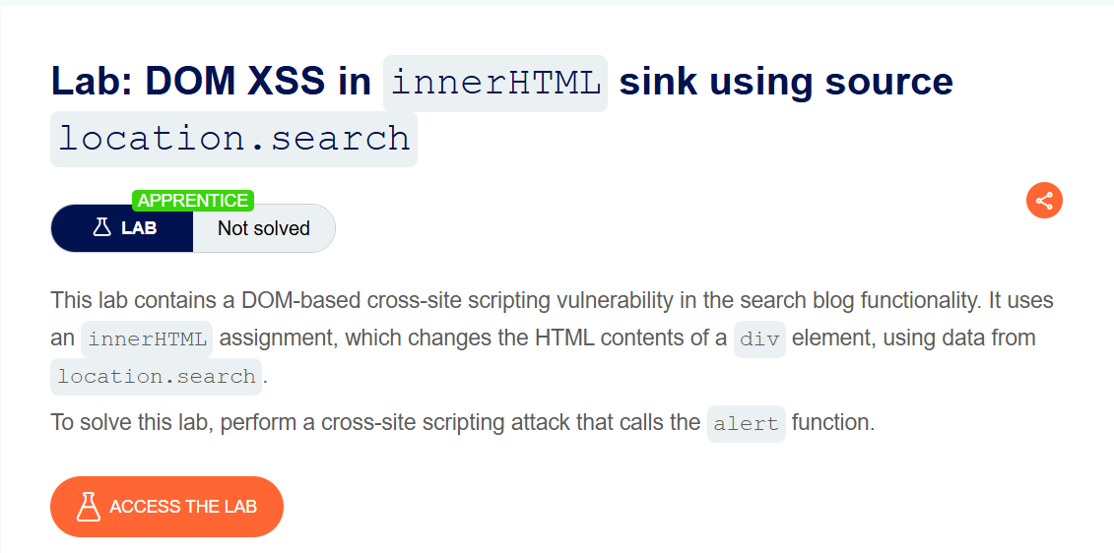
Lab 4: DOM XSS in innerHTML sink using source location.search

Slide 18
Steps………………….
Step1: Open the BurpSuite (Portswigger).
Step2: Login Your Account.
Step3: click proxy and go to open browser.
Step4: search the url cross-site scripting(XSS) Labs.
Step5: then go to left-corner you will find the view labs.
Step6: select any XSS Labs and see the solution and copy the script.
Step7: click access the lab & paste the script blog box.
Step9: Finally you found the flag and the room is completed.

Slide 19
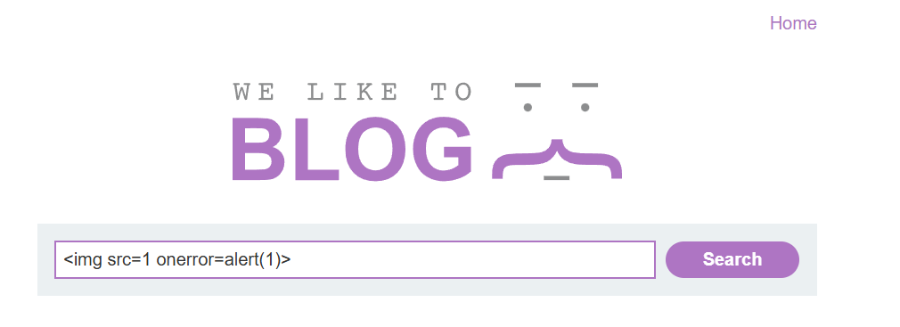
Created by pritam
We click access the lab.
We paste the script
<img src=1 onerror=alert(1)>

Slide 20
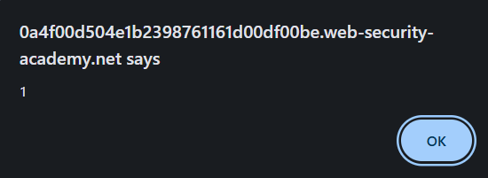
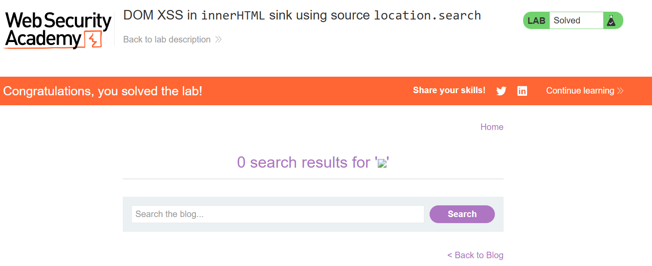
Created by pritam
(We Find the flag.)
(The Lab is solved.)

Slide 21
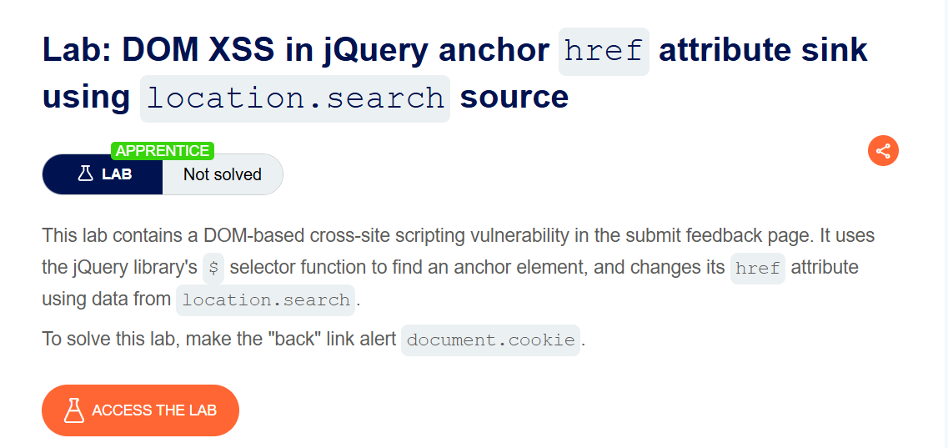
Lab 5: DOM XSS in jQuery anchor href attribute sink using location.search source

Slide 22
Steps………………….
Step1: Open the BurpSuite (Portswigger).
Step2: Login Your Account.
Step3: click proxy and go to open browser.
Step4: search the url cross-site scripting(XSS) Labs.
Step5: then go to left-corner you will find the view labs.
Step6: select any XSS Labs and see the solution and copy the script.
step7: access the lab and click submit feedback button.
step8: go to the submit feedback and scroll down the back button to right click.
step9: right-click and go to inspect for source code.
step10: change the img src with the script "javascript:alert(document.cookie)" .
step11: Also change the url parameter to change with the same script and the lab will be solved and go to the back button the falg will be found.

Slide 23
Created by pritam
(Click access the LAB.)

Slide 24

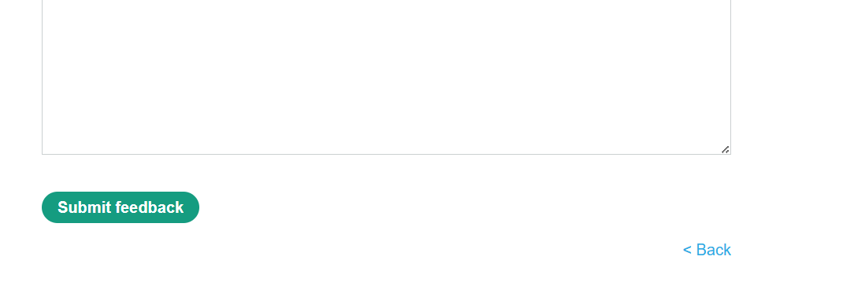
Created by pritam
(Click submit feedback button.)
(Scroll down for seeing back button and right click.)

Slide 25
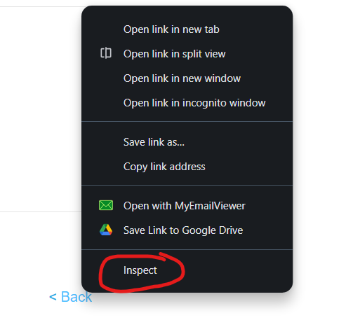
Created by pritam
Go to inspect for changing the code

Slide 26
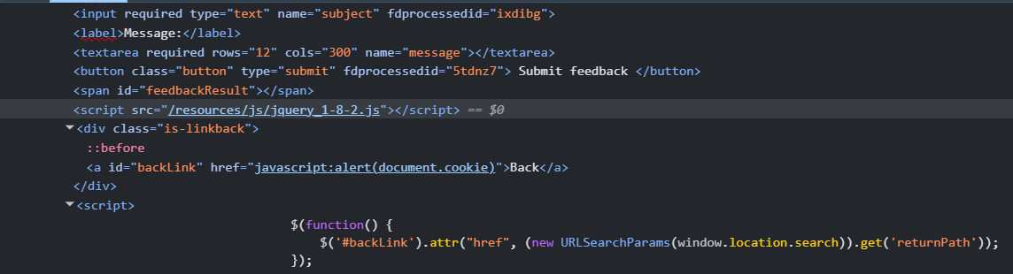
Created by pritam
href = “javascript:alert(document.cookie)” will replace in / parameter.

Slide 27
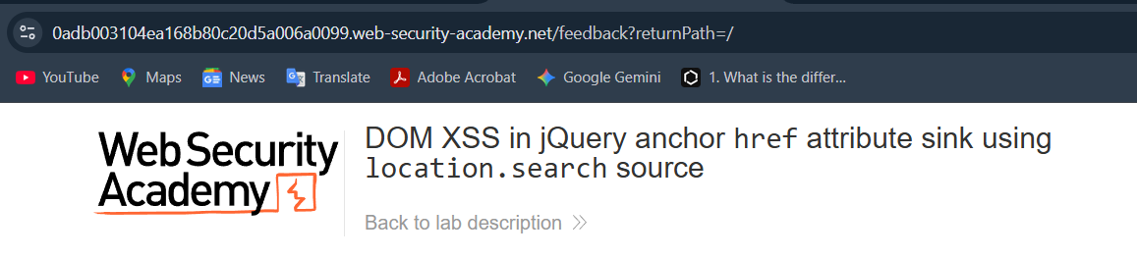
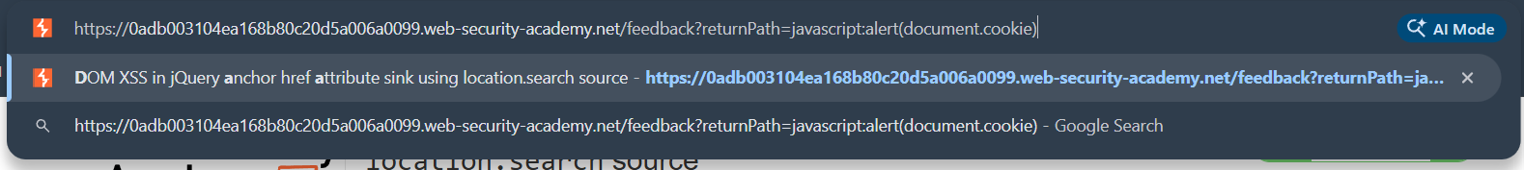
Change the returnpath=/ to javascript:alert(document.cookie)
Then click it.
CREATED BY PRITAM

Slide 28
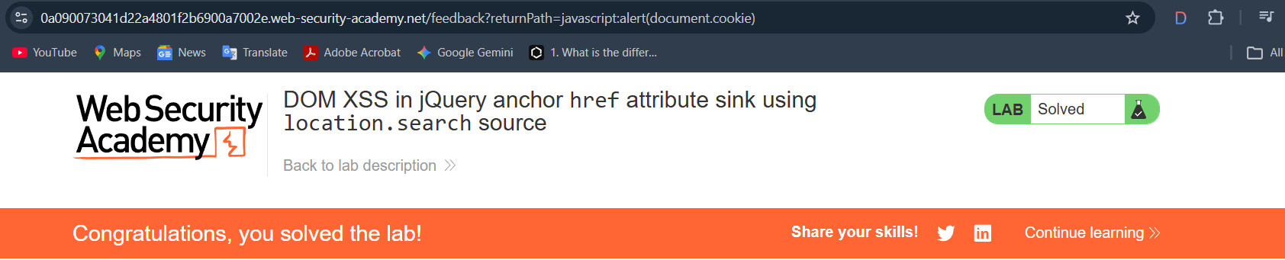
Created by pritam
(The Lab is Solved.)

Slide 29
THANKYOU

